Slide 1
Bank Analytics Project
Tools Used: Excel | Power BI | MySQL
Presented by :
KANCHAN

Slide 2
Agenda
Introduction & Objectives
Project Scope
Dataset Description & Preparation
Dashboards & Visualizations
SQL Queries
Findings & Insights
Challenges & Conclusion

Slide 3
Introduction
Project Focus: Bank Analytics – analyzing banking data and financial data.
Why Bank Analytics?
Helps detect fraud and unusual activity
Provides insights into customer spending and saving patterns
Supports decision-making at branch and organizational level

Slide 4
Objectives
Project Objective:
To clean and analyze banking data.
To build interactive dashboards for loan analytics and ongoing trends.
To write SQL queries to extract and analyze key metrics.
To provide meaningful business insights that support better banking decisions.

Slide 5
Project scope
Data Coverage:
Customer details (Client ID, Name, Age, Religion)
Loan data
Tools Used:
Excel: Pivot tables, charts, dashboards
Power BI: DAX measures, Interactive dashboards, advanced visuals
MySQL: Data extraction, queries, aggregation & insights

Slide 6
Project scope
Dashboards Developed:
Bank Analytics Dashboard
Outcomes:
Clear visualization of loan and transaction patterns.
Actionable insights for customer behavior .

Slide 7
Data description & Preparation
Datasets Used:
Bank Analytics Dataset – Rich loan-level data with customer demographics, loan amount, funded amount, interest, principal, loan status, categories, repayment details, and branch information.
Cleaning:
Checked for duplicate records and handled missing values.
Standardized formats. (dates, amounts, currency)
Final Output: Two clean, structured datasets ready for analysis & visualization.

Slide 8
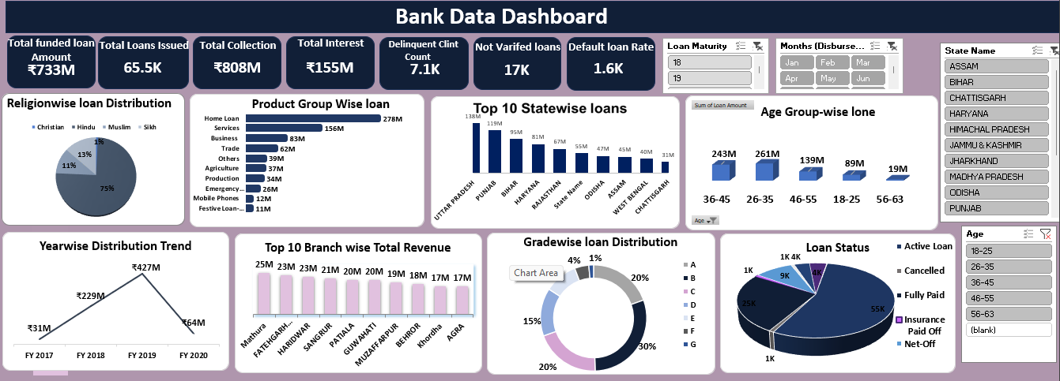
Dashboard - excel

Slide 9
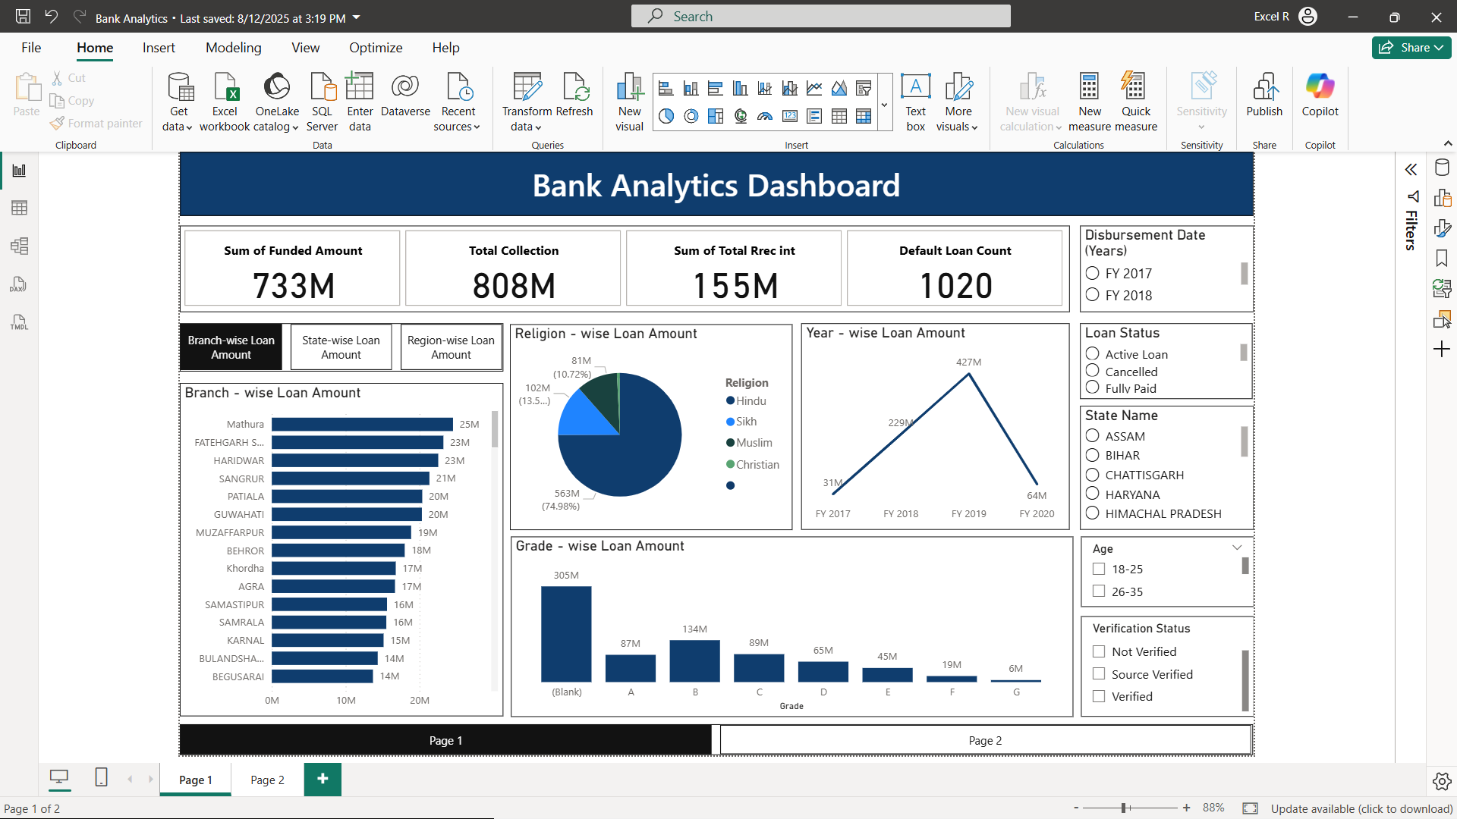
Dashboard – Power bi

Slide 10
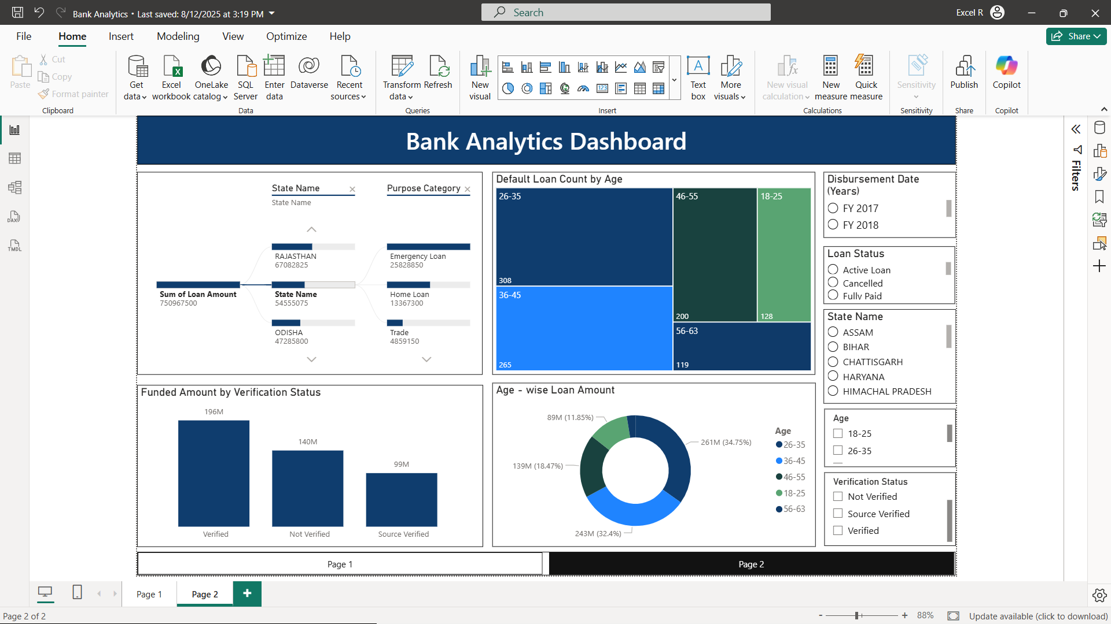
Dashboard – Power bi

Slide 11
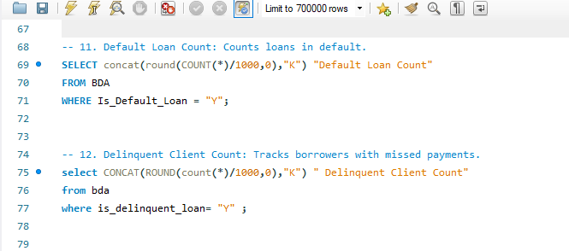
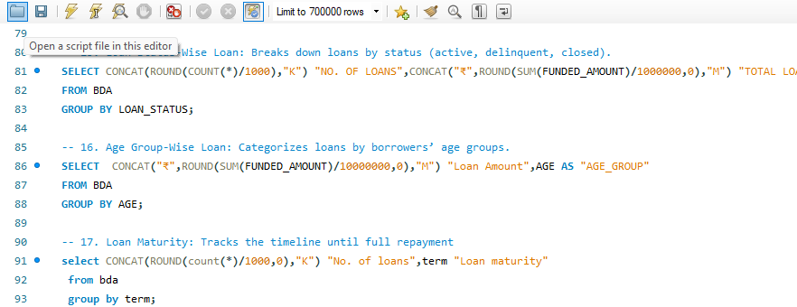
Mysql – Bank Analytics queries

Slide 12
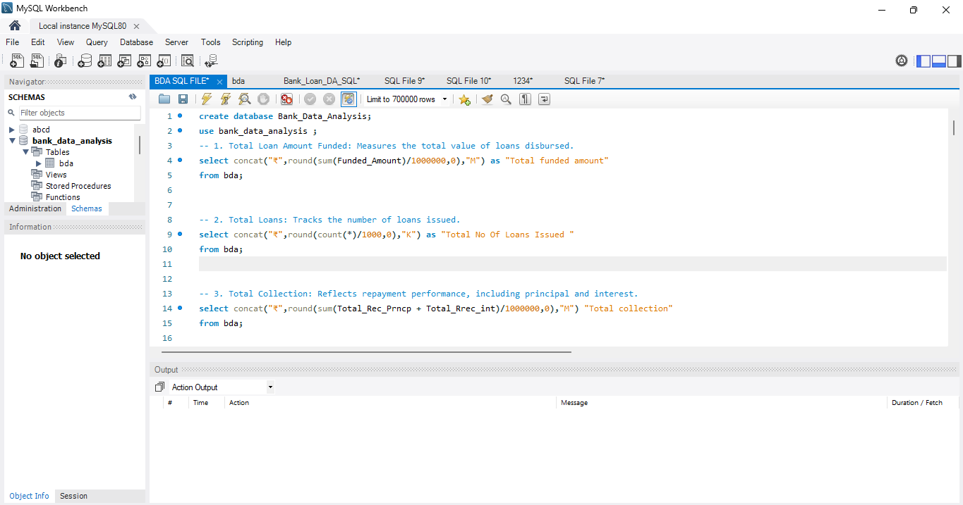
Mysql – Bank Analytics queries

Slide 13
Key findings
Bank Analytics Dashboard:
Majority of loans concentrated in specific age groups and regions.
Certain purpose categories (like Home Loan, Services, Business) show higher loan demand.
Noticeable number of delinquent/default loans, highlighting risk areas.
Verification gaps in loan approval process identified.

Slide 14
OVERALL Insights
Customer Segmentation – Loan demand is higher among working-age customers, while older customers maintain stronger balances.
Branch-Level Performance – Some branches show stronger credit inflows, while others have higher debit activity.
State-level Performance- Maximum loan amount is disbursed in states like Utter Pradesh ,Punjab and Haryana.

Slide 15
Challenges
Data Quality Issues – Duplicates, missing values and inconsistent entries had to be cleaned before analysis.
Complex Dataset Structure – The Bank Analytics dataset had many columns which made selecting relevant fields difficult.
Defining Meaningful KPIs – Translating raw data into metrics (Branchwise loan, statewise loan, Total funded loan etc.) required multiple iterations.
Visualization Balance – Ensuring dashboards were not only data-rich but also simple and user-friendly was a constant refinement task.
SQL Data Loading Errors – Initial data load was incomplete, leading to wrong query results. We had to reload both datasets to get accurate insights.

Slide 16
Conclusion
The Bank Analytics dashboard provides a clear understanding of customer financial behavior and loan management patterns. Through this analysis, we observed that:
Loan demand is concentrated among working-age customers, primarily for business and personal purposes.
While most loans are successfully disbursed, the presence of delinquent and default cases highlights the need for stricter verification and monitoring mechanisms.

Slide 17
THANK YOU!

